Slide 1
HOMEWORK 1 Due 03/07 00:00 send to e3

Slide 2
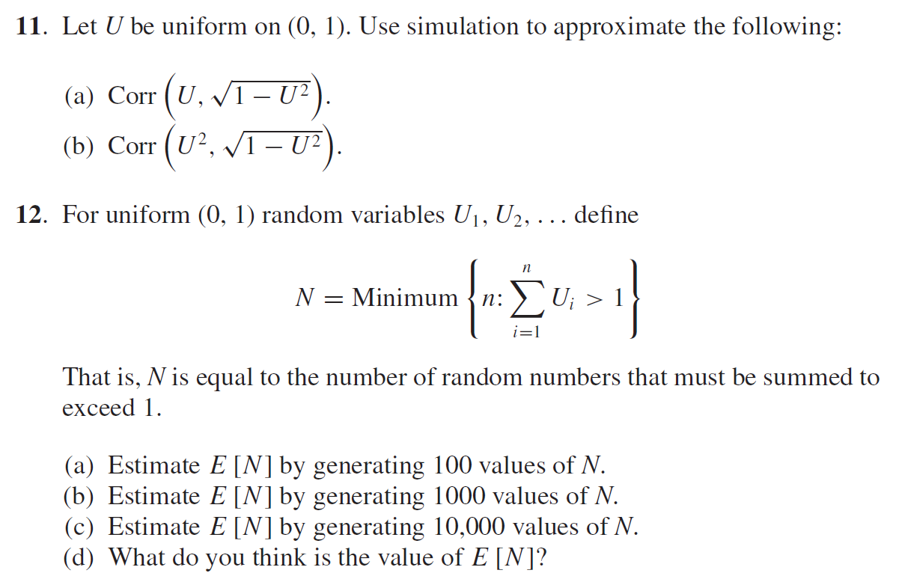
30% Each
10% Each

